Slide 1
Introduction to R and R Studio
NTUST Social Science & Business Research Methodology 12/26/2018

Slide 2

A little about myself
Computer Science and Biological Science from Carnegie Mellon University
Research Assistant at Pfizer Inc.
Ph.D in Bioinformatics from Boston University
Research Fellow at Massachusetts General Hospital, Harvard Medical School
Associate Director of Center for Cancer Computational Biology at Dana Farber Cancer Institute
Director of Data Science Center and Senior Research Scientist at Harvard School of Public Health

Slide 3
Outline
Why R is better than Python (don’t @ me)
Why R is better than SAS
Why R is better than Excel or Prism
Install and try out

Slide 4
Resources
https://rafalab.github.io/dsbook/
http://r4ds.had.co.nz/
https://www.edx.org/course/data-science-r-basics
https://www.datacamp.com/
R-bloggers
Stackoverflow

Slide 5
Why is R better than SAS
R is free
R is open source
New methods come out in R first
Large helpful online community
With tidyverse R syntax not as hard to learn
RStudio
R markdown
Shiny apps
gganimate
Interoperable: Rcpp, reticulate, htmlwidgets

Slide 6
Why is R better than excel and Prism
Reproducible research
Much easier to automatize repetitive tasks
Many more powerful tools
More flexibility

Slide 7
Install
Google: CRAN
Google: RStudio

Slide 8
In this session, we will learn…
https://www.rstudio.com/wp-content/uploads/2016/01/rstudio-IDE-cheatsheet.pdf
Install packages: example tidyverse
Create RStudio projects
Importing data
Perform t-test
Repetitive tasks
Dot Plot

Slide 9
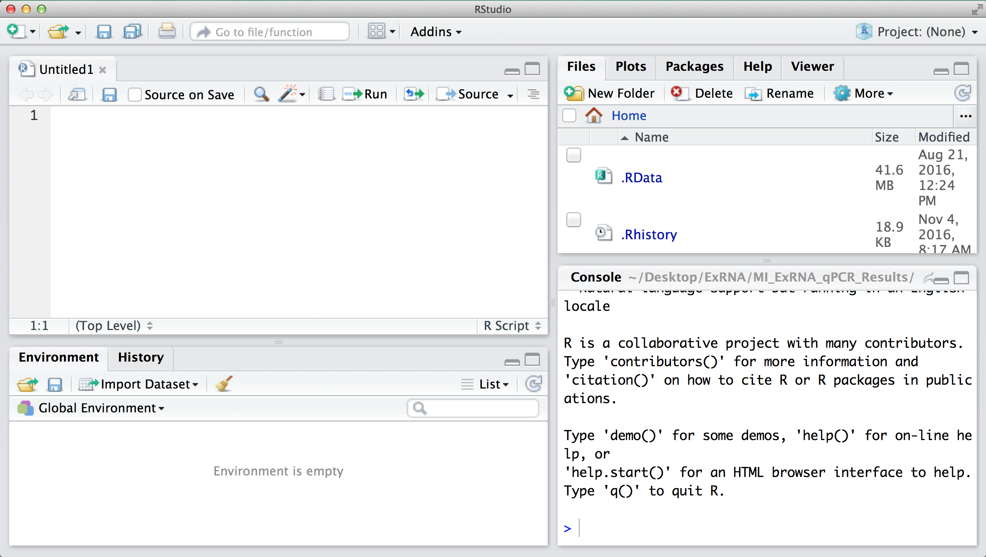
Getting familiar with your R installation and Rstudio

Slide 10
Coding- the importance of being exact
> f <-2
> F + 1
Error: object 'F' not found
Case matters!
Try not to use spaces
Sometimes you simply cannot: variable names cannot contain spaces
Even if it is valid (such as in file names) it just makes things more difficult
> FA <-2
> F A + 1
Error: unexpected symbol in "F A"

Slide 11
Download Demo Code from Github
https://github.com/yaoyu-e-wang/R-course

